Slide 1
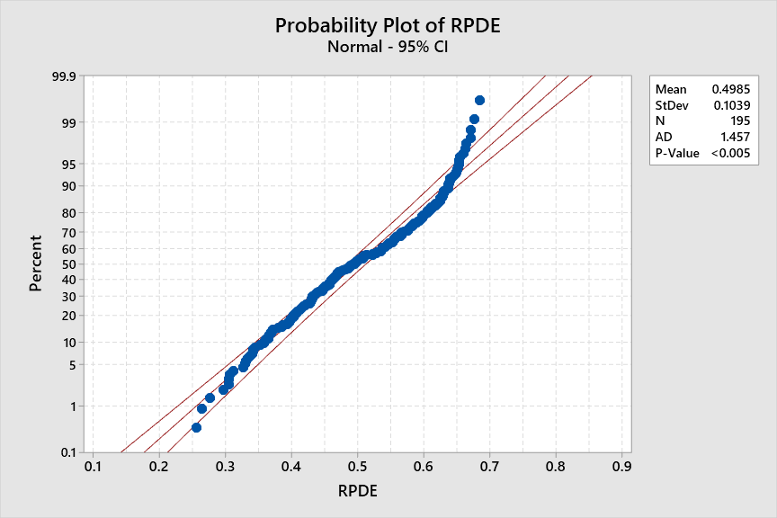
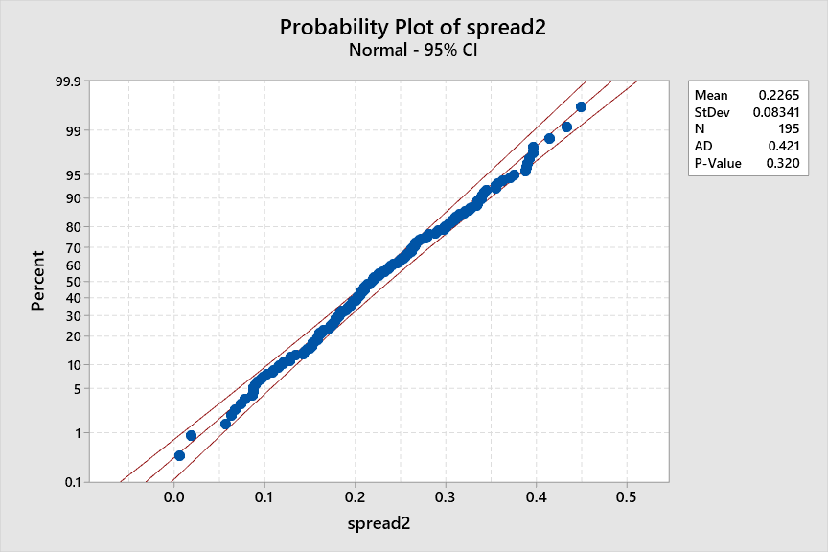
Normality Tests
Normality Tests are done to determine whether the attribute is normally distributed with some tolerance. We check for the P – Value, If the P-value is less than (0.005), then the attribute fails to be normally distributed. On the other hand, if the P-value is more than (0.005), then the attribute follow the normality.
Example of an attribute which doesn’t follow normality.
Example of an attribute which follows normality.

Slide 2
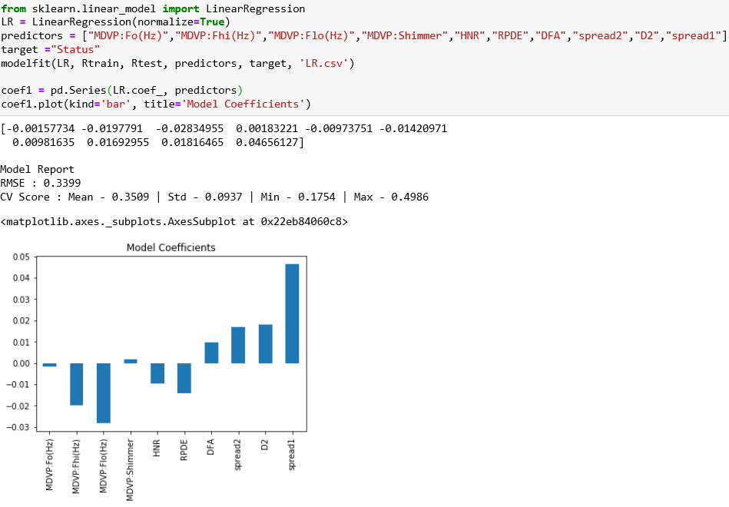
Linear Regression
Linear Regression tries to find a relationship between two or more variables and estimates one variable based on the others.
Model
Co-efficients

Slide 3
Regression Equation
As seen from Graph, it seems that spread1 is the most important for predicting the status followed by
MDVP: Flo(Hz) and so on, as shown in the below equation:
X represents the values gotten from the voice records, where (x1 ) is the value of MDVP: Fo(Hz) and respectively for
the other attributes. Y represents a range between (0,1) which indicates if the person has PD or not.
y = −0.00157734 x1 − 0.0197791 x2 − 0.02834955 x3 + 0.00183221 x4 − 0.00973751 x5 − 0.01420971 x6
+ 0.00981635 x7 + 0.01692955 x8 + 0.01816465 x9 + 0.04656127 x10

Slide 4
Conclusion
31 patients and a sample size of 150
Achieved the unmanageable statistic data of 24 different voice attributes to 10 manageable attributes which are not correlated to each other using different Statistical tools like Cross-Correlation etc.
Relationship between these reduced attributes is found out using linear Regression which can predict the status of the patient with 94.8% Accuracy.
non-standard methods in combination with voice discriminators could be 94.8% capable of separating individuals with PD from healthy ones.

